Slide 1
ArchiMate®
Case Study

Slide 2

Who are you?
What’s wrong?
How do we fix it?
Notes:
NATURE of a designer

Slide 3

A man with a watch knows what time it is. A man with two watches is never sure.
Notes:
This is called Segal’s law.
OUR PROBLEM –
DIFFERENT stories
PLETHORA of problems
INNOVATION OVERLOAD
Yet they had the MONEY – and would spend it on WHATEVER WAS “BEST”
We could provide EVIDENCE of the RIGHT solution for STAKEHOLDERS

Slide 4

I’m leaving!
You HAVE to help us!
Notes:
FIRST INVOLVEMENT
HELP US support them!

Slide 5

Who are you?
What’s wrong?
How do we fix it?
APPLICATION
Notes:
BRING CLARITY with Archimate
BE SPECIFIC about something “BESPOKE”
SO THAT → WE COULD HELP

Slide 6
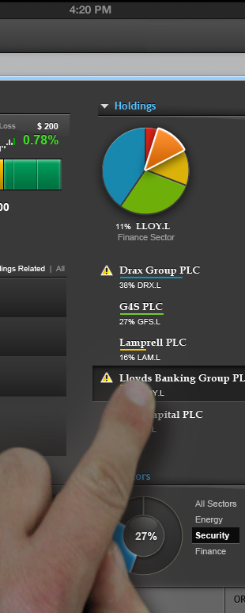
Components Stuff you can deploy
Functions & Services Characteristics and outcomes of the tools
Interfaces Ways to achieve outcomes
Data Stuff that’s consumed, brokered, and given
Notes:
Let’s NOT OVER-THINK →
Let’s FOCUS
Let’s LEARN QUICKLY →
Let’s be COMPLETE

Slide 7
We can’t adapt!
I’m leaving!
You won’t understand OUR database!
No way you could BUY one for OUR needs!
The system is REALLY INSECURE!
We are going to be massive!
It costs LOADS to get at our data!
We need gamification platform!
Our mates down the road are brilliant!
You HAVE to help us!
We HATE off-the-shelf systems!
Notes:
WHILE THIS WAS HAPPENING
HELP! IT’S INSECURE!

Slide 8
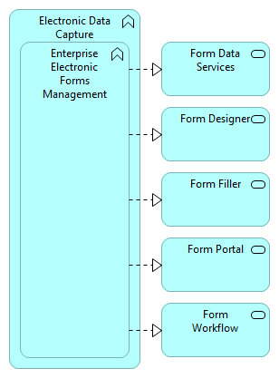
Notes:
FUNCTIONS and SERVICES of applications
Avoided arguing about what BI was – not just then but today
Clarified what they THOUGHT their systems did
FUNCTIONALLY described what they thought these types of systems do
With it we could describe what they HAD, what was MISSING, and what they NEEDED.
SIMPLICITY brought CLARITY
SIMPLICITY brought COMMUNICATION
NOT DESIGN but RESEARCH

Slide 9
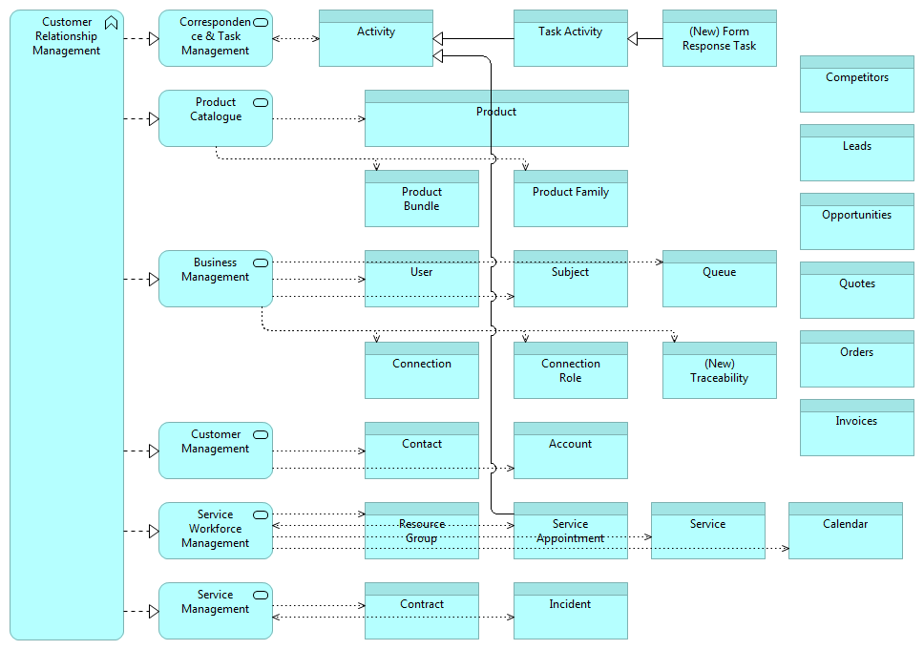
Notes:
MAINTAINS CONNECTIONS – Tasks!
LEARNT they didn’t JUST HAVE ONE TOOL
NOT A PROBLEM
QUICK RESPONSE to those that DON’T like CONSTRAINTS

Slide 10
We’re going to be GLOBAL and HUGE
NO! MY team needs to be upgraded first!
We can’t adapt!
I’m leaving!
You won’t understand OUR database!
No way you could BUY one for OUR needs!
Don’t you DARE upgrade my team first!
MY team needs to be upgraded first!
The system is REALLY INSECURE!
We are going to be massive!
It costs LOADS to get at our data!
It’s not the system, it’s our offering!
We need a gamification platform!
Our mates down the road are brilliant!
What does our supplier do again?
Our work is TOO different to use ONE system
Our processes need to be better joined up
You HAVE to help us!
We HATE off-the-shelf systems!
Notes:
STAKEHOLDERS → COMMENTS & QUESTIONS
RISK of OVER-COMPLICATING
RISK of LOSING CLARITY

Slide 11

Who are you?
What’s wrong?
How do we fix it?
APPLICATION
BUSINESS
Notes:
Turned to ARCHIMATE
PROMPT for COMPLETENESS
RE-ASSURANCE of UNDERSTANDING

Slide 12
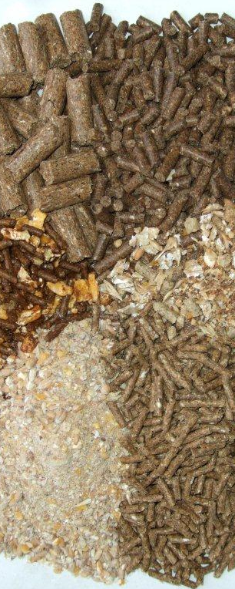
Actors & Roles The workforce you can deploy
Functions & Services Characteristics and outcomes available
Interfaces Ways to access the business
Objects Stuff that’s consumed, brokered, and given
Notes:
So we moved to ask about the BUSINESS system –
Notionally SIMILAR to applications

Slide 13
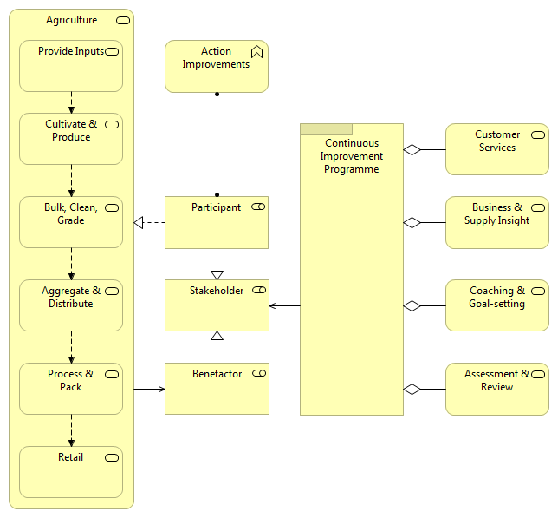
Notes:
GUIDED US TO PRODUCE THIS
Their supplier did A LOT MORE than provide a forms solution.
GENERALIZING – OPENED THE DOOR
WHAT IF
WHY NOT
COULD WE
DRILL DOWN and EXPAND OUT
ASK: DOES IT FEEL TRUE?

Slide 14
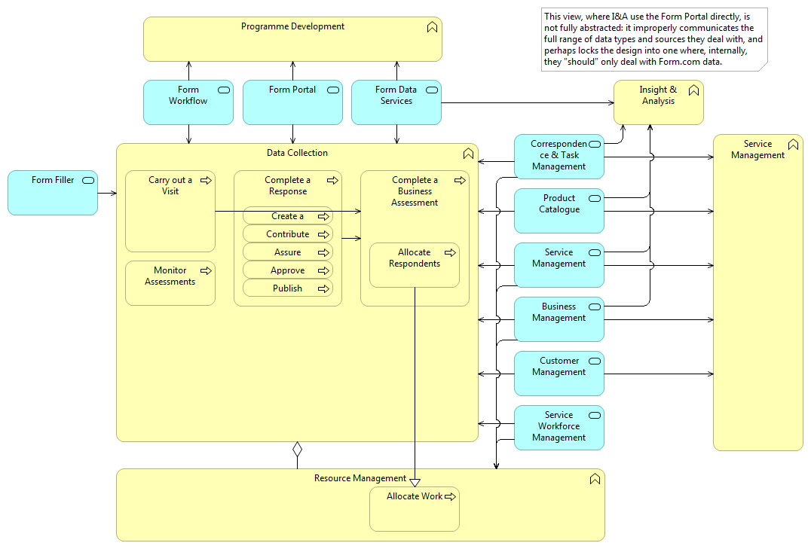
Notes:
PROOF – ANY team collecting data could use COMMON FUNCTIONS

Slide 15
We’re going to be GLOBAL and HUGE
NO! MY team needs to be upgraded first!
You should buy one!
We can’t adapt!
I’m leaving!
You won’t understand OUR database!
No way you could BUY one for OUR needs!
You need to prioritise team Y
Don’t you DARE upgrade my team first!
MY team needs to be upgraded first!
The system is REALLY INSECURE!
You need to prioritise team X
We are going to be massive!
You should build one!
What’s taking so long!
It costs LOADS to get at our data!
It’s not the system, it’s our offering!
We need a gamification platform!
But what about the drains in Hackney?
Our mates down the road are brilliant!
What does our supplier do again?
Our work is TOO different to use ONE system
Our processes need to be better joined up
You HAVE to help us!
We HATE off-the-shelf systems!
Notes:
RED HAT
RECOGNISE → ACCEPT → REFLECT - SAFELY

Slide 16

Who are you?
What’s wrong?
How do we fix it?
MOTIVATION
APPLICATION
BUSINESS
Notes:
EMOTIONAL
CLARITY
CONTROLLED ENGAGEMENT
SPECIFIC OUTCOMES
CLEAR PROCESS

Slide 17

Stakeholders & Drivers People that care and what they care about
Goals & Requirements Desired results and how to achieve them

Slide 18
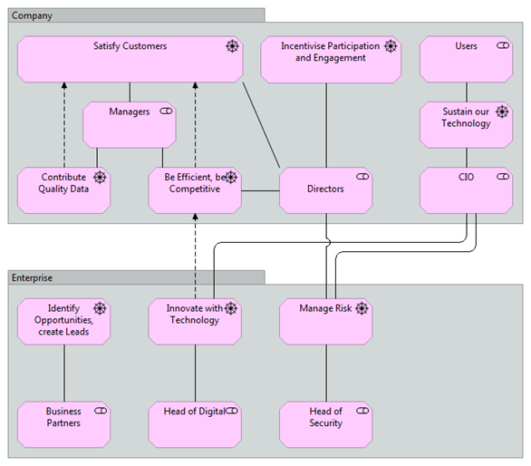
Notes:
BROUGHT PEOPLE TOGETHER
“COALITION” for CHANGE
Talk through some of the ASSESSMENTS
GUT → HEAR PEOPLE / USE THEIR ENERGY / CRITIQUE & ORGANIZE

Slide 19

Who are you?
What’s wrong?
How do we fix it?
MOTIVATION
TECHNOLOGY
APPLICATION
BUSINESS

Slide 20

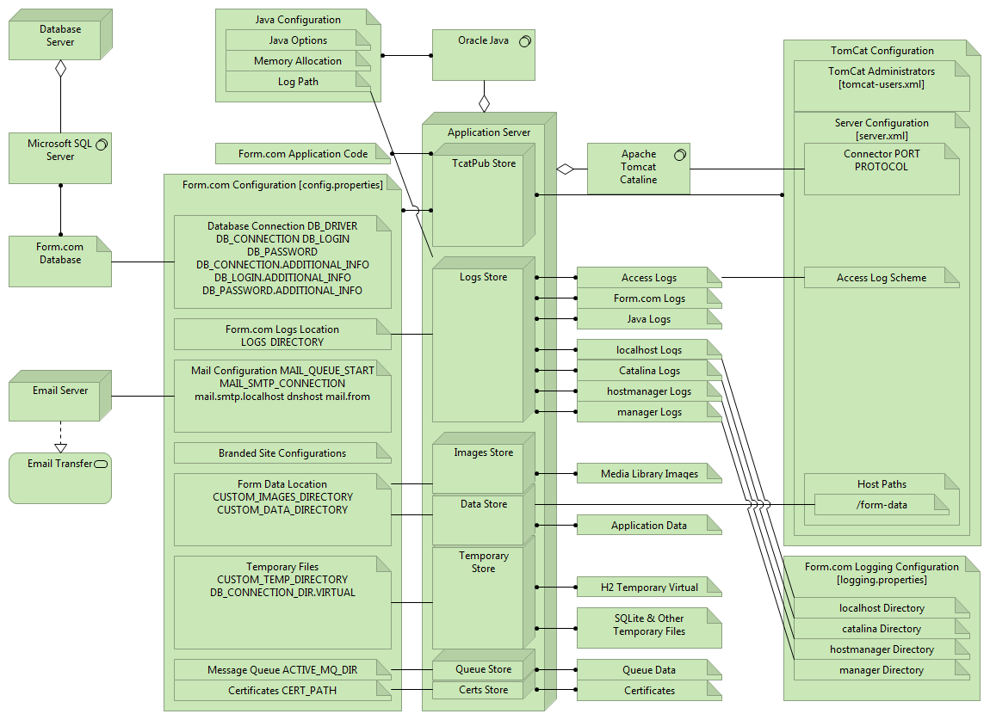
Notes:
MOST RECENT:
TECHNOLOGY LAYER for PERFORMANCE problems
SETTINGS
DEPLOYMENTS
SERVERS
NETWORKS
DEPENDENT SERVICES

Slide 21
ArchiMate®
Long-value output
A catalogue of evidence
A Process to follow
Basis of conversation
Consistent presentation
Brings people together
Specific things to make
A complete picture
ACTION
BELIEF
CONCLUSION
ASSUMPTION
INTERPRETATION
SELECTION
REALITY
FACT
Notes:
MAY NOT give ONE WATCH
But DOES CRITIQUE the WATCHES

Slide 22
How do you currently design services? What’s the process? How can you tell “a priority” from “a real priority”? Who documents your capabilities?

